Slide 1
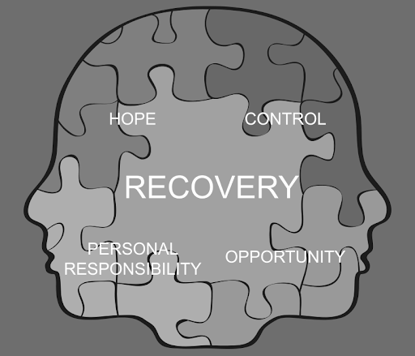
Absent Authority
Evaluating California’s Conservatorship Continuum
Alex V. Barnard
Department of Sociology
Notes:
Good afternoon, thank you for the chance to be here. Special thanks to the California Elder Justice Coalition for their support for my research.
My name is Alex Barnard, I’m an assistant professor of sociology at New York University, and graduate of UC Berkeley. As part of that project, I’ve spent some of the last three years examining California’s conservatorship system. I’m going to argue today that the system is one of “absent authority”. Conservatorship is both a serious deprivation of civil rights and a powerful tool of transformation. But the system lacks accountability to ensure that these two are in balance.
Before I jump in, I want to offer two disclaimers. First, what I’m presenting are general tendencies. One thing that’s clear from my research is that there is huge statewide variation, and I haven’t been able to speak with every stakeholder or representatives from every county. This is a preliminary report and I welcome corrections and critiques.
Second, I want to emphasize that while I’m going to be very critical of the conservatorship system, I have deep respect for the people working within it. I’m focused not on why professionals and advocates make bad decisions, but why there are often no good decisions to make.

Slide 2
Introduction / background / methodology / findings / recommendations Changing Rates of Involuntary Treatment
California is imposing more short-term involuntary ‘holds’…
…But putting fewer people onto long-term conservatorships.
Notes:
So I want to start with something of a paradox. Although we lack good reliable data, it appears that California is putting more and more 72-hour involuntary psychiatric ‘holds’ on its citizens and, in general, there’s been a long-term trends towards more 14-day 5250s as well.
But in spite of this, the number of people going onto 30-day temporary conservatorship and one-year permanent conservatorships is going down. Note that there’s a different in scale on the two graphs. What this tells you is essentially that less than 1% of people in such serious condition that they are deemed a danger to themselves, others, or gravely disabled and forcibly brought to a psychiatrist hospital are still there 17 days later.
Ideally, this decline in conservatorships would be because people are quickly stabilizing and returning to voluntary, community-based services. But as unfortunately many of you know, what is happening instead is that California is subjecting people to many, many short-term and often traumatic interventions, without putting them onto any long term trajectory towards stability or transformation.

Slide 3
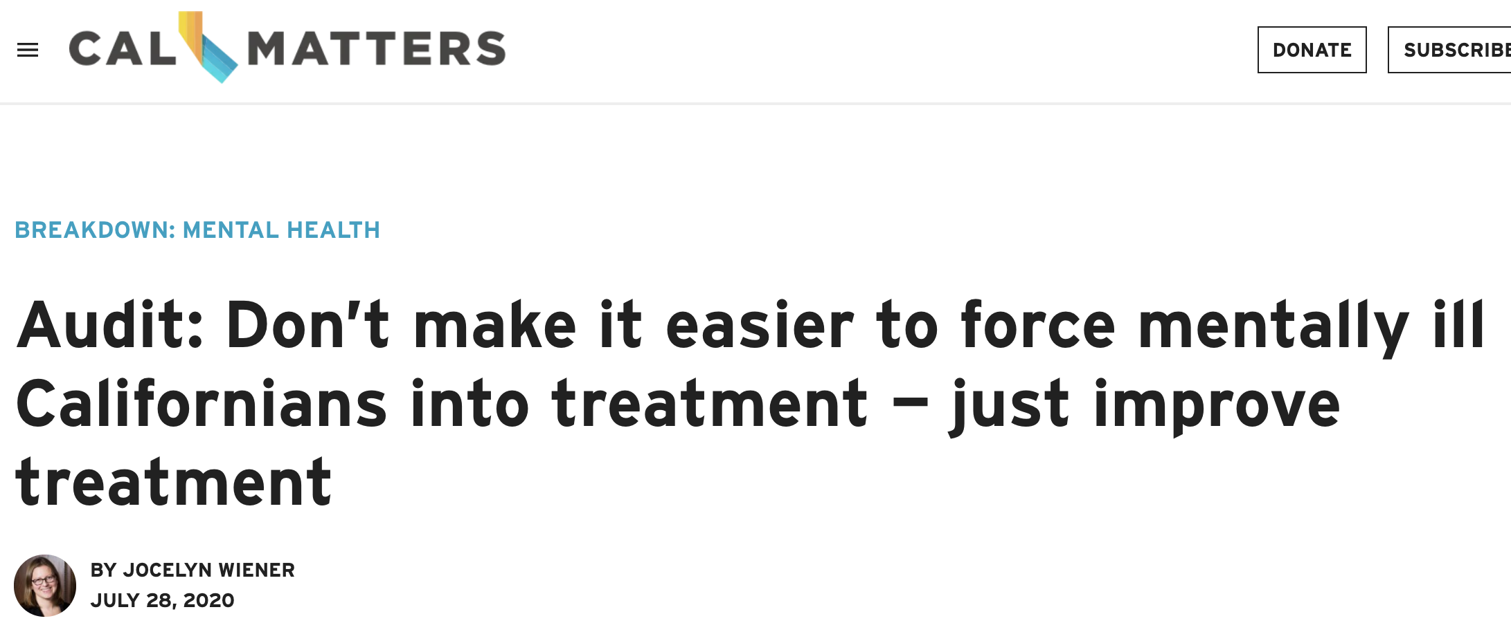
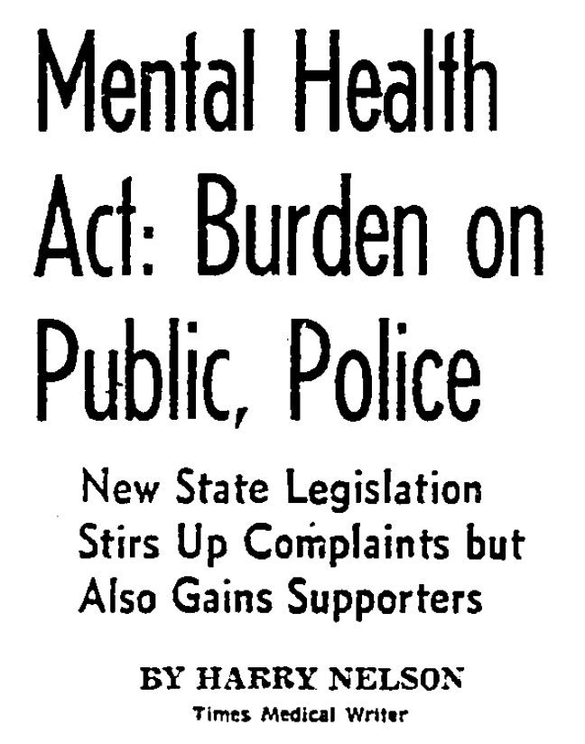
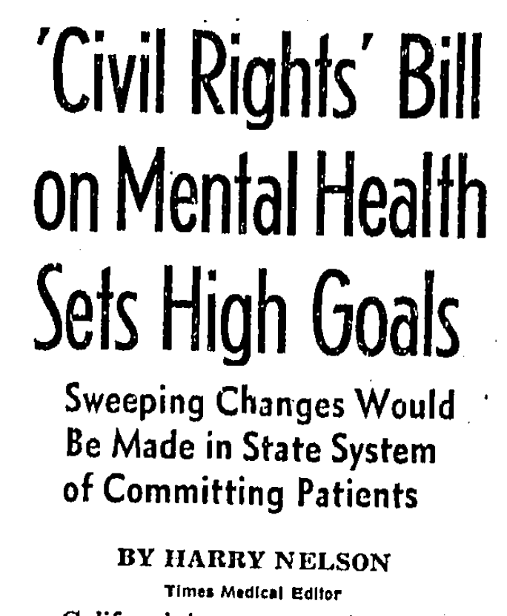
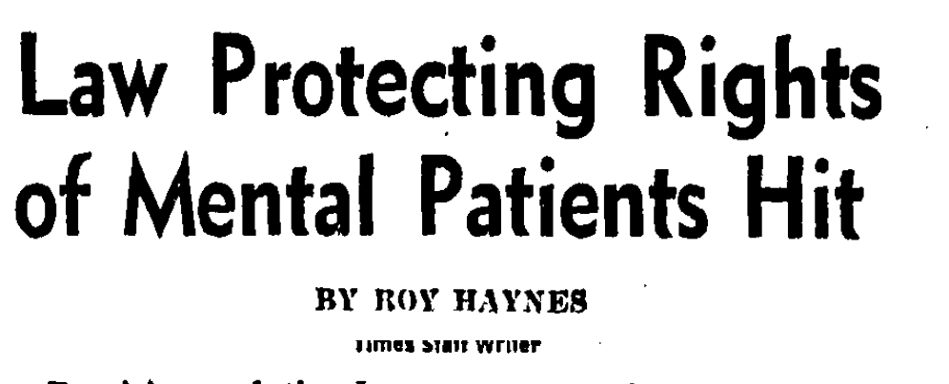
Introduction / background / methodology / findings / recommendations Competing explanations
The criteria are too strict.
We’ve been having this debate for a long time:
We just need more services.
Notes:
So why isn’t California’s mental health system working for some of the people dealing with the most severe conditions?
One argument is that the main barrier to getting people needed services are the criteria and procedural protections given by the 1967 landmark Lanterman-Petris-Short Act. LPS was once hailed as a “bill of rights” or “magna carta” for the mentally ill. But, as 2012 report on reforming LPS claimed, it is really only a “bill of rights” “for those individuals who are well enough to respond to treatment in a voluntary mental health treatment system.”
The opposing argument is that the people currently refusing services would accept them if they were more abundant and higher quality. This perspective often implies that just about every problem in the system would be solved by increasing funding.
I’ve been looking at media on the LPS Act reaching back to 1967, and as you can see from these headlines, the debate has been the same for decades. On one hand, we blame the ACLU and civil libertarians, and the other, Ronald Reagan and the stingy legislature.

Slide 4
Introduction / background / methodology / findings / recommendations Absent authority
My argument: New criteria and new funding alone do not address ”absent authority” in the conservatorship continuum.
“Absent Authority”: Conservatorship is a powerful tool, but one has clear responsibility for using it or accountability for insuring it achieves positive outcomes.
Sources of absent authority:
Information: Regulations and resource constraints lead to superficial evaluations and inconsistent decisions.
Coordination: Decision-making is delegated to a range of public and private actors with different interests and incentives.
Resources: A lack of placements creates a sense of futility throughout the continuum.
I would really suggest having nominal sentences (no verbs) and simplify. I’m not sure you need the separation between argument and findings on the slide (you’ll have in the notes). Also no need to repear « absent authority »
The idea of « conservatorship continuum » could be its own bullet point since you are introducing a new concept.
What does « them » refer to??
Example of simplification
Decision-making delegation to private providers de-favoring conservatees
Inconsistent definition of grave disablity
Resource constraints pusing to remove people from the continuum
Notes:
My talk is going to analyze what I am calling the “conservatorship continuum” – the series of medical, bureaucratic, and legal steps that leads someone from the community onto a conservatorship and into a usually locked placement.
The evidence I’m going to show confirms that both of the positions I just outlined are partly true: LPS criteria are being applied strictly in a way that keeps some people from getting help and the system is desperately underresourced. However, what I want to show today is that neither new criteria nor new beds is sufficient to address the issue of ”absent authority.”
By “Absent Authority”, I mean that conservatorship is a powerful tool, but one actually has clear responsibility for using it or accountability for insuring that conservatorship achieves positive outcomes, despite the dedication and commitment of many of the people working in the continuum.
I’m going to emphasize three things that are ‘absent’.
First, information. Both regulations and resource constraints force many professionals to conduct superficial evaluations and to use key criteria like ‘grave disability’ in inconsistent ways.
Second, coordination: Decision-making in the continuum is delegated to a range of public and private actors with different interests and incentives. There is no ensure that interventions are aligned.
Finally, resources. Decision-makers along the continuum adapt to past failures to get people onto conservatorship – mostly due to resource constraints – by removing future potential conservatees from the continuum, even when they themselves think someone merits it.

Slide 5
Introduction / background / methodology / findings / recommendations
Financing
Mental health and substance use treatment account for a small and declining share of health spending.
Source: WHO Mental Health Atlas; Mark, Tami L., Tracy Yee, Katharine R. Levit, Jessica Camacho-Cook, Eli Cutler, and Christopher D. Carroll. 2016. “Insurance Financing Increased For Mental Health Conditions But Not For Substance Use Disorders, 1986–2014.” Health Affairs 35(6):958–65.
Notes:
I am a comparative sociologist, and I think that as unique as the United States and the Independent Republic of California might seem, we can learn a lot from putting our system into perspective. I’m going to start with five slides on the financing, scope, infrastructure, and use of involuntary treatment.
First point is that mental health accounts for a small and declining share of health spending. Now less than 6%. Substance abuse services add another one to two percent. Despite the opioid epidemic, overall funding for substance use has gone down.

Slide 6
Introduction / background / methodology / findings / recommendations
Financing
Mental health and substance use treatment account for a small and declining share of health spending.
Higher overall health spending does not make up the gap.
Source: WHO Mental Health Atlas; Mark, Tami L., Tracy Yee, Katharine R. Levit, Jessica Camacho-Cook, Eli Cutler, and Christopher D. Carroll. 2016. “Insurance Financing Increased For Mental Health Conditions But Not For Substance Use Disorders, 1986–2014.” Health Affairs 35(6):958–65.
Notes:
This puts as at the very low end of developed countries. In fact, places like France or the Netherlands spend virtually twice as much of their health budget on mental health and substance use services. Although the U.S. spends more in general, this is not enough to make up the gap.
It’s harder to get precise numbers for California, but they’re likely quite similar.

Slide 7
Introduction / background / methodology / findings / recommendations
Specialty mental health Coverage
Within the U.S., specialty mental health services in CA reach a comparatively small part of the population.
Source: SAMSAH Uniform Reporting System (2019).
Notes:
Within the U.S., specialty mental health services in CA reach a comparatively small part of the population, a little less than 2%, versus a national average of 2.5%.
There are a lot of grains of salts to put into this because states count differently. I’ve cut out five outlier states on each side. But, for example, if you want to compare us to other large states, California serves a little bit more of its population than Texas and only half as much as New York.

Slide 8
]
Introduction / background / methodology / findings / recommendations
Acute Care Beds
Compared to other developed countries, California has fewer psychiatric beds per capita.
This is more dramatic if we take out forensic beds.
Source: OECD Health State ; California Hospital Association(2019)
Notes:
Compared to other developed countries, California has fewer psychiatric beds per capita – about .3 per 1000
This is more dramatic if we take out forensic beds, which are about a quarter of the California total.
Important to note that there are countries with robust mental health systems that do not have a ton more beds – and some like Italy that have very, very few.

Slide 9
Introduction / background / methodology / findings / recommendations Involuntary care
But California uses high rates of short- and medium-term involuntary treatment.
Source: Sheridan Rains, Luke, Tatiana Zenina, Marisa Casanova Dias, Rebecca Jones, Stephen Jeffreys, Stella Branthonne-Foster, Brynmor Lloyd-Evans, and Sonia Johnson. 2019. “Variations in Patterns of Involuntary Hospitalisation and in Legal Frameworks: An International Comparative Study.” The Lancet Psychiatry 6(5):403–17.
Lee, Gi, and David Cohen. 2020. “Incidences of Involuntary Psychiatric Detentions in 25 U.S. States.” Psychiatric Services
Notes:
Given this, I am really surprised to show you the attached graph, which looks at the rate of involuntary holds and hospitalizations in different countries. As you can see, California has a very high number of 5150s, (although some states, like Florida) have even higher. These data are likely an undercount. Even for longer-term 5250s, which last for fourteen days and are the step before a temporary conservatorship, California is still up there.
How can we reconcile this with what I just showed you? Well, people are using those beds for a very short period of time. And a large proportion of care is being given on an involuntary basis, because people can only get into a hospital when they are in acute and often extreme crisis.
So to summarize: the U.S. doesn’t spend a lot on health care, California has comparatively fewer beds and a low penetration rate for public speciality mental health services, and nonetheless winds up with high levels of involuntary care.

Slide 10
Introduction / background / methodology / findings / recommendations
Qualitative study of conservatorships
An ethnographer interested in medical and bureaucratic decision-making.
Comparative research on the ‘alternative path’ taken by France
Sainte Anne’s Hospital, Paris
Notes:
So, as a bit more background – who am I. I’m someone who is interested in bureaucratic and medical decision-making and social policy. I study mental health partly out of personal interest, and partly because if you want to understand how governments intervene in the lives of their citizens, there are few people with more different agencies intervening than people with severe mental illness.
I’m also a comparative research. I study the U.S. versus France, where a system that looked very much like our own made a different set of choices in the 1960s. While the U.S. rapidly closed its hospitals and cut hospitals off from community care, France integrated them into a single public system. It’s a system that is both more protective and more paternalistic.
I’ve spent five years trying to understand how these policy choices translate on the ground, conducting observations in clinics, social service offices, courts, and Ers, and I’m writing this as a book, tentatively entitled “Mental States.”

Slide 11
Introduction / background / methodology / findings / recommendations
Qualitative study of conservatorships
Interviewees
Field |  |  | Profession
Advocacy | 11 |  | Psychiatrist | 20
Hospital | 23 |  | Lawyer | 23
Outpatient | 22 |  | Social Worker | 28
Housing | 10 |  | Psychologist | 12
Public Guardian | 20 |  | Nurse | 6
Courts | 21 |  | Other M.D. | 5
Professional Org. | 5 |  | Judge | 7
Family Advocate | 18 |  | Advocate | 34
Government | 11 |  | TOTAL | 141
Additional Sources:
Published literature on LPS.
~600 newspaper articles on LPS, 1967-present.
Administrative statistics.
Observations with FSP Team.
Participation in working groups: conservatorship, long-term care.
Notes:
What I’m presenting today is one piece of this project. You’ll hear me harp on this multiple times, but there is very little available data on conservatorship. We do not have comprehensive statewide data on who is on conservatorship, where they are, or how they got there.
My approach is more exploratory. As you can see, I’ve interviewed 136 different stakeholders across 29 counties. I contacted the Public Guardic and LPS Public Defender in most counties, although their rate of response was very low. I also interviewed psychiatrists, parents, advocates, judges, and outpatient clinicians.
I’m also using additional sources, including the published academic literature on LPS, 600 newspaper articles on LPS and conservatorship from 1967 to the present, availabie administrative data, observations with an FSP team that treated clients who had been or were heading towards conservatorship, and participation in working groups around conservatorship and long-term care.
I’ll talk briefly about the limitations of this metho in the conclusion.

Slide 12
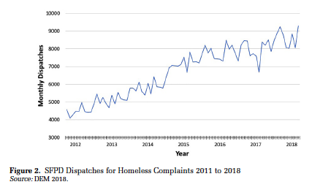
Introduction / background / methodology / findings / recommendations
5150’s and community evaluations
Use of 5150s to address visibly disruptive street behavior.
Difficult to use 5150s for invisible deterioration at home or in shelters.
Quick and superficial evaluations by police and mobile crisis teams.
Need for private initiative to overcome lack of public authority.
“Police see people who are high, and a 5150 is an easy way to get them off the street. The ER won’t admit them, and they come back. The system is kind of functionally-dysfunctioning.”
– County MH Director
SF PD Dispatches for “Homeless Complaints” (Source: Herring 2019)
Notes:
First step on the continuum is usually a 72hour hold. 5 – 20% of conservatorship applications come from the CJ system, but that’s not my focus today.
Today 5150s are used by police to address complaints about disruptive street behavior. The chart on the left shows the rising number of “homeless complaints” being received by SFPD. A county mental health director explained the solution that has emerged: “Police see people who are high, and a 5150 is an easy way to get them off the street. The ER won’t admit them, and they come back. The system is kind of functionally-dysfunctioning.”
The result of this ‘functioning-dysfunctioning’ is that some people, disproportionately racial minorities, cumulate huge numbers of holds. At one hearing in San Francisco, for example, the Department of Behavior Health reported that nine people had visited psych emergency 168 times in the last four months.
But what I discovered is that can be very difficult to get a 5150 for someone who is invisibly deteriorating in a way that is not generating lots of complaints. One woman recounted calling the police repeatedly for her psychotic son: “He thought I was a prison guard trying to poison him, so he stopped eating….I called the police several times. But their evaluation is just a flash. He was locking himself in the garage and he had the door chained, so you couldn’t open it. And if he wouldn’t come out and they couldn’t open the door, then they’d just say ‘he’s not right, but sorry there’s nothing we can do’
She then explained, “On the sixth time, he was lying on the couch, and I got an experienced—he was probably in his fifties—law enforcement officer who came, and I showed him a picture from [my son’s] driver’s license, and then looking at him, skin and bones, the officer said ‘I’m going to call him gravely disabled.’ But it took that much. We’re talking about 80 pounds, 100 pounds weight loss for it to be addressed.”
What I am illustrating here are two aspects of absent authority. First, MCT and police often are making decisions based on quick and superficial evaluations of peoples’ momentary state. Moreover, these public authorities often require repeated and persistent private initiative to intervene. Some families reported that police themselves had advised them to make their children homeless so they would be able to take them in.

Slide 13
Introduction / background / methodology / findings / recommendations
Emergency departments
Simplest reason for low ER admit rates: bed availability:
But ER decision-making also de-favors potential conservatees:
Emphasis on ‘danger’ over ‘disability’
Skepticism of ‘addicts,’ ‘frequent flyers’ or ‘incarceritis’
Sense of futility for potential conservatees.
“If I’m filling out a 5150, I have to check a box, and I’ll almost always do danger to self or danger to others. Those are more likely to get them in than [GD]. [GD], they [ER doctors] are not impressed by that”
– Outpatient Psychiatrist
Notes:
The simplest reason that police and mobile teams are reluctant to place people on holds and transport them to hospital Emergency Departments is that they know ERs are one of the strictest filters in the process. For example, only 9% of all people who visit San Francisco General’s Psychiatric Emergency Services are ultimately admitted; the figure for John George in Alameda County is 12%.
The simple explanation for this is that there are fewer and fewer places for ERs to admit people to. California has lost 40% of its inpatient capacity since 1995, and some hospitals no longer take LPS patients. While the number of state hospital beds has increases slightly, 90% of them are reserved for forensic cases.
But ER decision-making also de-favors potential conservatees. First, with the limited personnel and resources of overcrowded emergency departments, attention and concern goes towards people who are dangerous and disruptive over those who are debilitated and deteriorating. One FSP psychiatrist reported on her strategy for hospitalizing patients from the community: “If I’m filling out a 5150, I have to check a box, and I’ll almost always do danger to self or danger to others. Those are more likely to get them in than [GD]. [GD], they [ER doctors] are not impressed by that”
Second, ER clinicians are skeptical of people they perceive as “addicts,” those who are “frequent flyers” who are using the ER for a place to sleep and get a meal, or people suffering from “incarceritis” – a sudden onset condition where someone under arrest declares they need to go to a hospital. Someone placed in these groups may be released even if they also have a serious mental illness.
Finally, the clinicians I spoke to felt a sense of futility about potential conservatees because . One ER Intern explained:
Sometimes I’m like, ‘Look, we can admit them, but nothing is going to come of this,’ admit them for five days under some bullshit excuse and at the end of the day what’s going to happen? This patient doesn’t want our help. You and I both know this person has no capacity. This person needs to be conserved, but it doesn’t work that way; it takes them months to get conserved. We look at each other and say, ‘We don’t have another bed. They’re going to get discharged one way or another.’ After I’ve fought for these patients, I am beaten to the ground emotionally and mentally…To me a trauma case [for example, someone with a gunshot wound] is so easy, quick, know all the steps, works like a well-oiled machine. These cases are where my time, effort, and energy go (Interview, 4/6/18).
As I am emphasizing today, the sense that there’s no one further down the continuum to help someone means that people upstream may just give up.

Slide 14
Introduction / background / methodology / findings / recommendations
Inpatient Hospitals
Extreme financial disincentives to applying
For-profit hospitals extra reluctant to apply?
Applications based on ‘fail repeatedly’ principle… and resource availability.
“The bed availability does affect who ends up getting the care they need… You’re not going to send the person to the street if they’re completely psychotic, covered in their own feces, but if it’s a wobbler, ‘okay am I going to apply for conservatorship here? Wow, there’s absolutely no beds, it’s going to be a six-month waitlist…’ It will make me think twice”
– Inpatient Psychiatrist
Notes:
In my research, the number one blocking point in the conservatorship continuum is getting an acute inpatient hospital to apply and hold a person while a conservatorship is putting into place.
Inpatient clinicians face enormous pressures to discharge. Interviewees described insurance companies that call after 24 hours of someone not being acutely suicidal demanding release or hospital management throwing pizza parties for those discharging patients fastest. The result has been a collapsing length of stay: in 1990, people stayed an average of 25 days in acute care hospitals. In 2010, the median stay in community hospitals was six-and-a-half days
One more speculative finding from my research is that financial pressures have a particularly strong impact on California’s conservatorship continuum because of the ownership structure of California’s psychiatric hospitals. As you can see from the chart, our mental health system is heavily reliant on for-profit hospitals – nearly 50% of beds, versus one-sixth for regular hospitals.
The core of the problem is that once someone is stabilized and just waiting for a conservatorship application to go through or to find a placement, MediCal might pay the hospital only an “administrative” rate, which at 600 a day is only half of their “acute care” rate.
The medical director of one for-profit hospital explained “Sometimes, MediCal can refuse to keep you in the hospital based on acuity, even if the legal criteria are met. In this kind of a situation, you have a doctor, a judge, and maybe the person in the community who hospitalized the person who are all in agreement, but insurance isn’t. When someone is no longer a danger to self or others, but just gravely disabled, we are no longer paid at the acute-care rate. When they’re is just waiting for a bed somewhere else, it’s the administrative rate. In that case, we might have to discharge them” (Interview, 4/4/18).
Unsurprisingly, then, interviewees confirmed that a much smaller number of public hospitals account for most applications. Most of these applications came as part of a “fail first and repeadtly” system. One inpatient psychiatrist explained: It [conservatorship] is for people who have failed at all lower levels of care. They’ve been working with an outpatient team, we’ve tried an Acute Diversion Unit, residential placement, tried to live independently, and repeatedly come to the emergency room, and they just have trouble with medication compliance and they wind up in different cycles of care and don’t seem to maintain outside of a structured environment (Interview, 3/12/19).
Even for people with repeated failures, though, resource constraints can be determinative. One psychiatrist explained “The bed availability does affect who ends up getting the care they need… You’re not going to send the person to the street if they’re completely psychotic, covered in their own feces, but if it’s a wobbler, you ask, ‘am I going to apply for conservatorship here? Wow, there’s absolutely no beds, it’s going to be a six-month waitlist…’ It will make me think twice”

Slide 15
Introduction / background / methodology / findings / recommendations
Public Guardians
Unstable funding, sometimes marginalized institutional status, and unclear role and responsibilities.
Decision-making by Public Guardians:
Strong concern for civil rights:
Focus on identifying ‘successfully’ vs. ‘unsuccessfully’ homeless:
“Taking away someone’s right to self-determination if a big step, it’s the last thing you want to do as a conservator” – Public Guardian
“We’ve had clients who are homeless by choice…You or I may not feel that’s good for them, medical health wise or mental health wise, but it’s their choice, and if they can articulate that, ‘I go to the soup kitchen, I go to Goodwill, I have Social Security, and I use that income to buy those clothes, and I have a sleeping bag, that’s what I want,’ well, the doctor may not feel that’s appropriate, but if they’re able to articulate that…we may reject that referral” – Public Guardian
Notes:
Public Guardians’ offices work with irregular funding, often report feeling marginalized within departments of human services or health, and have an unclear set of responsibilities for conservatees.
Of all the people I interviewed in the continuum, Public Guardians were often the most wary of using conservatorship. As one told me, “Taking away someone’s right to self-determination if a big step, it’s the last thing you want to do as a conservator.” This has made some of them resistant to increasing pressures from county boards of supervisors, family members, or the general public to conserve more people
Public Guardians reported they excluded some people if their problems were identified as primarily related to drug use or dementia. But frequently, evaluations centered on determining whether someone was ‘successfully’ or ‘unsuccessfully’ homeless: “We’ve had clients who are homeless by choice…You or I may not feel that’s good for them, medical health wise or mental health wise, but it’s their choice, and if they can articulate that, ‘I go to the soup kitchen, I go to Goodwill, I have Social Security, and I use that income to buy those clothes, and I have a sleeping bag, that’s what I want,’ well, the doctor may not feel that’s appropriate, but if they’re able to articulate that…we may reject that referral”

Slide 16
Introduction / background / methodology / findings / recommendations
Courts
PDs express some concerns about available resources for legal representation.
Decision-making in courts:
Accepting superficial evidence a person can meet their needs:
Most effective defense: showing availability of a ‘3rd party assist’:
Because of prior screening, courts and conservators have little decision-making discretion:
“He was a heavy guy [the conservatee], he wasn’t starving, and so we could say ‘he’s feeding himself, he may be eating out of the garbage, but we know he’s eating.’ I got that guy off” – Public Defender
Estimated Petitions Filed on: 70-95%
Estimated Conservatees Not-Contesting: 50-75%
Estimated Rulings Establishing Cons.: 70-95%
Notes:
The next step is passage through the legal system. Most potential conservatees are represented by Public Defenders. In generally, people praised the dedication of public defenders to a sometimes difficult-to-serve clientele. But with high caseloads and clients spread across facilities,
Courts are also interested in identifying people who can survive on their own. One Public defender described a case, “He was a heavy guy [the conservatee], he wasn’t starving, and so we could say ‘he’s feeding himself, he may be eating out of the garbage, but we know he’s eating.’ I got that guy off.” Like 5150 evaluations, courts are supposed to process people rapidly, which makes many decisions based on only superficial statements that may go against what is known about what happened the last time the person was released.
The most effective strategy, though, is a ‘third party assist.’ – finding another party to take care of someone. Finding a less restrictive option is a good goal. But assuming that the public system should step only when there is absolutely no other option may not be what is in the person’s best interest, and may create pressure on families to take someone back even when they are asking for conservatorship precisely because they can no longer meet that person’s needs.
Still, I found that because screening at previous steps in the continuum was so strict, judges and Public Guardians actually had relatively limited decision-making discretion. Guardians file on 70-95% of petitions, somewhere between half and three-quarters of conservatees did not have a contested hearing, and the courts ruled to establish a conservatorship in between 70 and 95% of cases.

Slide 17
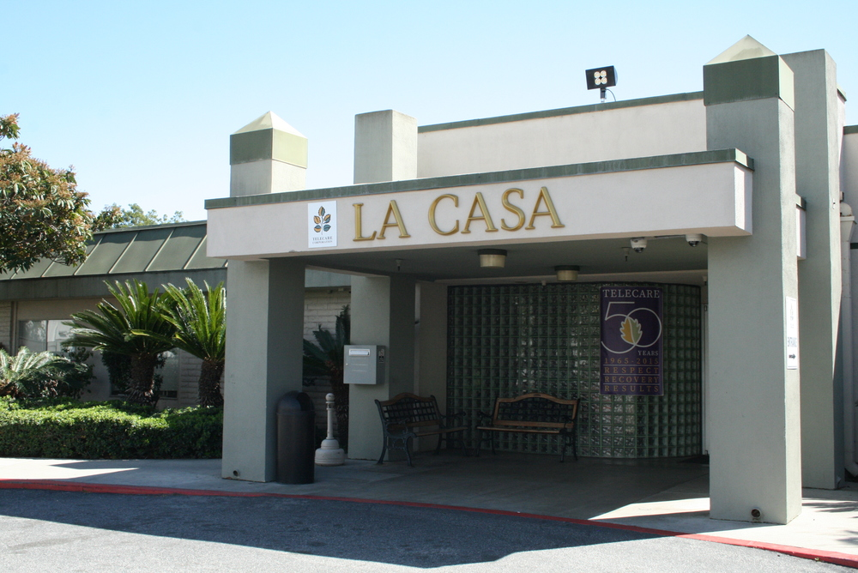
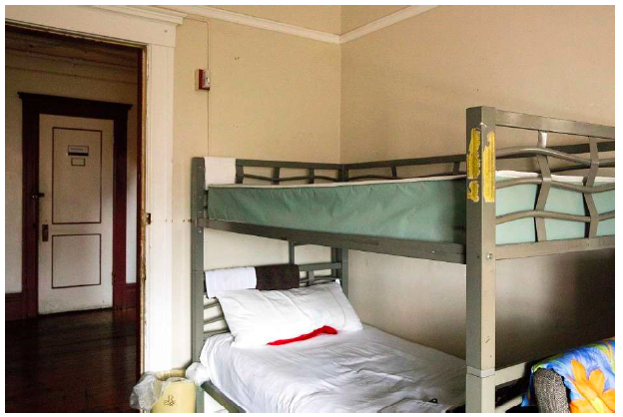
Introduction / background / methodology / findings / recommendations
Placements
Private providers are incentivized to ‘cherry-pick’ conservatees.
IMDs: Competitive county contracting facilitates excluding people with a violence history or criminal justice involvement.
Board and Cares: Pressure to switch to other populations (homeless, dev. disability) and preference for people w/o substance use or medical needs.
Locked “IMD”
Unlocked “Board and Care”
"We are completely at the mercy of the operators” – Public Guardian
Notes:
The last step of the conservatorship continuum is getting a placement, but it is also the one that drives decision-making all through it.
For most conservatees, there first step after a conservatorship being put in place is in a locked sub-acute facility, or IMD. Many interviewees accuse locked IMDs of ‘cherry-picking’ conservatees with no violence history or criminal justice history.
Disconnect with criteria used earlier in the continuum.
Want to emphasize – this is driven by fiscal reality, not preferences.
2/3rds of California IMD beds are controlled by two companies, so a person with a bad reputation with each could have a very difficult time finding a place. This is exacerbated by a system of competitive county contracting.
As one guardian told me: We tried to get a contract with [IMD]—it has a real recovery model, they care about their clients. We got my boss [head of the county Department of Health and Human Services] to take a tour. But we didn’t get it, because we don’t pay as much as other counties. We lost six beds in the last year, and it was very clear that it was because [large county] paid more…We are completely at the mercy of the operators (Interview, 4/24/19).
Counties vary in whether they will place people in Board and Cares. Interviewees both derided Board and Care conditions and lamented that they were disappearing. When I spoke to operators of large facilities, they described receiving dozens of requests a day from hospitals for maybe one or two open spots per month
For financial and regulatory reasons, it makes sense for them to choose people with no complex medical needs, drug use. One person in a county placement department told me: “We have one Board and Care that takes people near us. I know the guy who runs it very well…he gets to be so picky and so specific because he’s the only one. He can practically choose based on the color of someone’s hair. And he can certainly say, ‘No one with a walker because I just put in new floors’
The awareness of lack of placements drives decision-making throughout continuum.
One inpatient psychiatrist told me: “We always weigh the realistic limitations of the system. Where is the patient going to go once we put him on conservatorship, are there any places for him to go? A lot of times there aren’t. It’s almost not worth putting him on conservatorship, even if they need it…I wish it could be idealistic like that, ‘we can put everybody who meets this criterion on it [conservatorship] and there’d be a place for them.’ But there simply isn’t. You think down the line, ‘is there a long-term stabilization, sub-acute hospital that the [county] contracts with, maybe out of county? Would they take this patient?’ You think, ‘that waitlist can be three to six months, this patient is going to be in the hospital waiting.”
After evaluating in this way, many conclude that applying simply isn’t worth it.

Slide 18
Introduction / background / methodology / findings / recommendations
Services to conservatees
Some counties Public Guardians are ‘helicopter parents’:
In other places, conservatees a bit more like latch-key kids.
Huge variation in goals and practices of conservatorship:
We’re very involved in the lives of our clients. We’re going above and beyond to make sure their needs are met. We got one client into college and off of conservatorship, and she still calls her conservator asking for advice” – Public Guardian
Notes:
Some counties Public Guardians are ‘helicopter parents’:
We’re very involved in the lives of our clients. We’re going above and beyond to make sure their needs are met. We got one client into college and off of conservatorship, and she still calls her conservator asking for advice” – Public Guardian
These were generally smaller or better-resourced counties. Many larger ones, conservatees are a bit more like latch-key kids – conservators might be checking in only quarterly. In places where there is 80-100 conservatees per Public Guardian, there is no other option.
In terms of the objectives of conservatorship, there is enormous county variation. Public Guardians varied from saying their goal was to keep their clients alive, to get them off conservatorship, or to accompany them towards recovery and autonomy. Some large counties discharge people as soon as they leave a locked facilities, and in some small counties, conservators stay in contact as someone transitions to supported housing and voluntary outpatient care.

Slide 19
Introduction / background / methodology / findings / recommendations
Steps in ‘absent authority’
Police unlikely to 5150 for GD; need for private initiative
Financial disincentives to long-term care, particularly for private hospitals
Exclusion if 3rd party or have plausible plan for self-care
5150 hold
ER Admission
Hospital Application
P.Guardian Filing
Court Ruling
Placement
Strict application of criteria against GD, drug use, frequent flyers…
Exclusion of ‘successfully homeless’ able to meet minimal needs
Preference for conservatees w/o drug use, violence…
Absent Authority: No actor has information, resources, or coordinating capacity to mobilize everyone in the continuum.
Notes:
So, a quick overview of what I’ve said.
At the first step, we see that police are unlikely to 5150 someone from grave disability, and often require repeated initiative from private actors – like outpatient clinicians or family members – to take action.
ERs apply LPS criteria strictly and use grave disability less than danger. They also frequently discharge people whose problems are seen as primarily coming from drug use, poverty, or criminal justice contact.
Hospitals face intense financial disincentives against applying for conservatorship. My interviewees suggested that county hospitals were more likely to apply in spite of the financial implications than for-profit ones, some of which refuse to take LPS conservatees.
Public Guardians’ investigations often focus on whether someone is ‘successfully homeless’, or able to meet their needs in some very basic way.
Courts rule based on whether the person, at a given moment in time, can articulate a plausible self-care plan or find a willing third party.
California’s system of mostly private placements is able to impose on counties a preference for people without drug use, violence history, or complex medical needs.
What we see across these steps is absent authority: Absent Authority: No actor has information, resources, or coordinating capacity to mobilize everyone in the continuum.
I’m now going to briefly talk about recommendations. Two caveats: first is that this is not my expertis,e second is that I’m not going to focus on what everyone agrees with.

Slide 20
Introduction / background / methodology / findings / recommendations
General observations
We want the vast majority of people to exit the continuum.
But for the right reasons: accept treatment, less restrictive option, adapted third-party support…
Many people are exiting for reasons unrelated to statutory criteria or best interests:
No placements, no financial incentive to treat, lack of information sharing among providers, inconsistent application of criteria…
The powers of conservators / public guardians are often overstated:
Some power over conservatees but no one has control over conservatorship process.
The result in some cases is not protection of civil rights, but potentially repeated and ineffective rights deprivations.
This is an outcome no one in the continuum wants!
Notes:
We want the vast majority of people to exit the continuum.
But for the right reasons: accept treatment, less restrictive option…
Many people are exiting for reasons unrelated to statutory criteria or best interests:
No placements, no financial incentive to treat, lack of information sharing among providers, inconsistent application of criteria…
The result is not really protection of peoples’ civil rights, but potentially repeated and ineffective rights deprivations.
This is an outcome no one in the continuum wants!
But this should also frame debates – the current system is subjecting a lot of people to involuntary interventions, so defending it does not necessarily guarantee civil rights.

Slide 21
Introduction / background / methodology / findings / recommendations
Research and evaluation
Recommendation #1: Legislature or foundations should fund a systematic and comprehensive study into conservatorship:
System failures in the trajectories of conservatees
Changes in conservatorship over time
Evaluating existing programs and new models
We should not extrapolate from other programs (AoT) to say whether conservatorship ‘works’
The State Audit of LPS
Notes:
Recommendation #1: Expand Research into Conservatorship – I realize this is boring coming from an academic, but there is a real dearth of information. The last published studies are based on data from the 1980s.
Some of you may have heard of an audit that was conducted and released in 2020. Many people I spoke to were disappointed because it left many questions unanswered.
My research methodology allows me to do is to better identify what we don’t know.
Who is on conservatorship and where did the system break down such that conservatorship became necessary? What are conservatees’ objections?
Second, What is driving shifts in conservatorship rates and variation between counties? What placements are missing?
Third, what are their outcomes of conservatorship? For whom does it seem most effective: Do ‘Housing’ and ‘Community’ Conservatorships work?
Policy debates have often evoked research onto other programs, like AoT, but they serve different populations. We cannot extrapolate from AoT say whether conservatorship ‘works’ for people with drug use or criminal justice contact, for which many guardians are convinced it doesn’t.

Slide 22
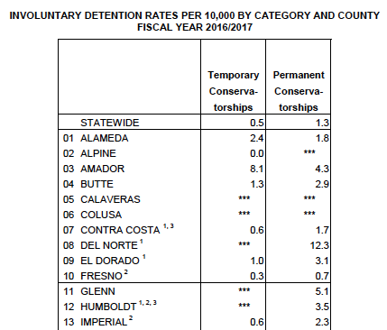
Introduction / background / methodology / findings / recommendations
Regulation and oversight
Recommendation #2: DHCS and other key stakeholders should create a new regulatory structure for conservatorship:
There is currently enormous variation by county.
This makes working with multiple counties difficult.
The state should have an LPS office setting guidelines around:
Service, placement types, conservatorship powers, applying grave disability…
Conservatorship rates by county
Notes:
Recommendation #2: Key state agencies – health care services, justice, courts - should convene key stakeholders – like the professional associations for Guardians, Behavioral Health Directors, and Public Defenders to create a new regulatory structure for conservatorship.
There is currently enormous variation by county. While we might think it’s good to let counties make decisions based on local needs, many facilities work with multiple counties and these inconsistencies create enormous problems. One state hospital doctor said that some counties do not allow involuntary medication of conservatees, while others do.
The state should reopen its LPS office, which apparently closed in 2012, to set guidelines around services, placement types, the powers of conservatorships, and applying grave disability. This office could also work to make sure that the kind of people who are on conservatorship are incorporated into policy discussions around the public mental health system.

Slide 23
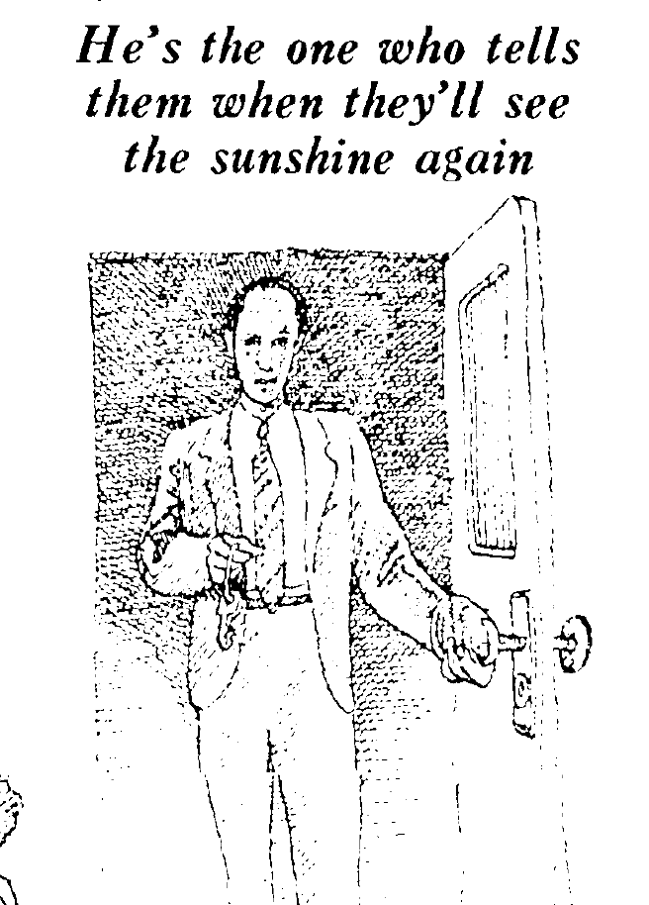
Introduction / background / methodology / findings / recommendations
Public Guardians and defenders
Recommendation #3: The legislature should fund an expanded role for Public Guardians and Public Defenders
Reformers largely overstate what conservators can do:
Better resourced Public Guardians could play a more proactive role in the continuum.
Public Defenders can find more effective ways to address concerns, investigate alternatives, and reduce constraint.
“They think it’s a magic wand, ‘oh let’s get them conserved and then everything will be solved.’ We only have two powers: placement and medication, and we have no placement budget” – Public Guardian
Notes:
Recommendation #3: Fully Fund and Reimagine Public Guardians and Public Defenders Many Public Guardians felt that the public had an image of them similar to this article from the LA Times in 1973, which describes them as having “Total Power.” Probably the recent case of Britney Spears has buttressed this image. In their eyes, though, reformers largely overstated what they can actually do. One told me, “They think it’s a magic wand, ‘oh let’s get them conserved and then everything will be solved.’” “We only have two powers: placement and medication, and we have no placement budget”
We should not confuse guardians' powers over conservatees with their control over the conservatorship process.
The audit did not address reforming public guardians’ offices, but I think we need to reimagine their role. One possibility is to move them towards a more proactive stance of identifying people in the county system who would benefit from conservatorship and coordinating their admission and application. This of course requires that they be much better resourced and given a clear and independent place in county government.
Finally, I believe that public defenders also need to be incorporated more into reform discussions. What became clear in my interviews with them is that peoples’ objections to conservatorship are on a continuum. Having someone on their team to advocate for them could help identify ways to make conservatorship less objectionable – I’ve heard about people who just wanted Doritors, to wear a green dress or, of course, to smoke.
New York’s Mental Hygiene Legal Services, a dedicated public agency, is one possible model. Any expansion of conservatorship needs to be combined with a revamped system for guarding conservatees’ rights. This could also include resources to support

Slide 24
Introduction / background / methodology / findings / recommendations
LPS Criteria
Recommendation #4: The Legislature should focus on improving LPS evaluations more than changing criteria
Is “Grave Disability”, in practice, whatever fills available beds?
Risks of changing criteria without new resources (SB 40/1045 in SF)
The state should strengthen mandates to incorporate history and background, and clarify privacy / evidentiary rules.
“In our county, we have 76 acute psychiatric beds. If all 76 are filled up, then grave disability means one thing. If they’ve got some beds or they can put some people in a sub-acute to free up some beds, then grave disability means something else. If we built a second acute hospital tomorrow, we doubled our capacity for involuntary acute care, we would find that there’s actually now 152 people who meet the criteria for grave disability, and if we shrunk it down to 30, we’d find that a lot of people, it turns out, are not gravely disabled” – Public Defender
Notes:
Recommendation #4: The Legislature and DHCS Should Focus on Improving LPS Evaluations Rather Than Changing Criteria. I recognize that this is one of the most live and acrimonious debates in California right now. I should say that I think grave disability is being defined too strictly in the sense that some people who need high intensity services are not getting it, and that the criteria are used to justify that.
But I also think the definition of grave disability is being set by available resources. Put another way, “Grave Disability” is, in practice, whatever fills available beds.
Public Defender: “In our county, we have 76 acute psychiatric beds. If all 76 are filled up, then grave disability means one thing. If they’ve got some beds or they can put some people in a sub-acute to free up some beds, then grave disability means something else. If we built a second acute hospital tomorrow, we doubled our capacity for involuntary acute care, we would find that there’s actually now 152 people who meet the criteria for grave disability, and if we shrunk it down to 30, we’d find that a lot of people, it turns out, are not gravely disabled”
One reason why I am convinced of this point is that “grave disability” used to be seen as the category that was so vague as to allow a workaround of strict laws. In one study from the 1980s, a lawyer told a sociologist, “When we’re arguing grave disability, anyone goes”.
On the other hand, without changing capacity, reforms to criteria are not likely to be iimpactful. SB 1045 / 40 in SF, which has to date conserved one person despite an enormous mobilization of human effort and resoures, is a cautionary tale.
What I do think we should be focusing on, however, is improving LPS evaluations. Currently, both regulations around privacy and clinicians limited resources and time mean that evaluations are typically done based on someone’s superficial immediate presentation.
This creates what sociologist Josh Seim calls ‘ambulance welfare’ – interventions that are as superficial as wrapping a wound in gauze. It also leads to clinicians trying the same thing over and over again and not take advantage of past experience around what does and does not work for someone.
What we need is mechanisms for those holds to turn into something more than another hold. Reforms and regulations should change to obligate and enforce the consideration of someone’s history, background, and collateral information in decision-making in order to avoid cyclical ‘people processing’. Interviewees also identified inconsistent interpretations of HIPAA and new evidentiary rules under the 2016 Sanchez decision as other key barriers. We might want longer hospitalizations but fewer of them.

Slide 25
Introduction / background / methodology / findings / recommendations
Funding and placements
Recommendation #5: DHCS and County Behavioral Health Departments should fund higher intensity services:
Apply for the IMD Waiver, but aim for quality and voluntary care.
Use MHSA funds to bridge conservatees towards recovery.
Evaluate the right mix of private innovation and public safety net.
Notes:
Finally, the need for higher level placements was a widespread view, although you should take this chart with a grain of salt because my interviewees are not a representative sample.
Many interviewees, actually thought there should be more beds somewhere other than where they worked, because they had so many inappropriate patients. One nurse who worked on a team specialized in caring for homeless people with mental illness confided, “Every person we treat needs a higher level of care” (Interview, 5/1/19).
In general, interviewees identified beds at the IMD level as the most desperately needed. My understanding is that the state is currently considering applying for a waiver of the IMD exclusion, which would free up MediCaid funds to finance inpatient care.
It should couple this with a new vision of how to use those beds. High intensity doesn’t have to mean involuntary. More people would be willing to stay if facilities were resourced to provide better care and they could stay long enough for hospitalization to actually solve some of their problems.
As many Public Guardians and the audit reported, conservatees have been under-considered in funding streams like the MHSA. These funds should be freed up to finance models intended to bridge people between conservatorship and purely voluntary outpatient services and supported housing, such as residential treatment or community conservatorship.
Finally, This research points to serious problems created by “cherry-picking” among clients by private long-term care providers (whether IMDs or Board and Cares). They often financially have no other choice, but this leads to people being inappropriately placed in truly “public” institutions (like state hospitals or jails).
At the same time, many of the most exciting models discussed were places like Psynergy or Everwell Health. The state needs to harness the innovative power of the private sector but recognize that emergency safety net services cannot just be left up to market forces or private initiative.

Slide 26
Introduction / background / methodology / findings / recommendations
Limitations
Methodological limitations
Currently underrepresented groups among interviewees: law enforcement, county BH departments, conservatees
Potential biases introduced by low response rates and skew towards larger counties.
Reliance on self-reports (although high consistency across interviewees) rather than direct observational data.
Limited and unreliable quantitative data to describe trends.
Closing Caveat: We ask our mental health system to ‘clean up’ for America’s failure to build a real social safety net, rectify racial and economic inequality, or end mass incarceration. Addressing these issues feels overwhelming, but it has to be on our agenda.
Notes:
Methodological limitations
Currently underrepresented groups: law enforcement, county BH departments, conservatees
Potential biases introduced by low response rates and skew towards larger counties.
Reliance on self-reports (although remarkable consistency across interviewees). Families blame hospital psychiatrists for not applying; psychiatrists agree they rarely apply. Conservators say that courts grant most petititons, PDs agree they usually use.

Slide 27
Thank you!!!
Alex V. Barnard
New York University
avbarnard@nyu.edu
If you’re interested in speaking to me
(on or off the record), please reach out.
Acknowledgments: I am grateful for the aid of research assistants Sierra Timmons, Kimberly Nielsen, Didi Wu, Michael Long, Yoshi Cohn, Sebastien Le Moing, and Amritha Somasekar. I have also benefited enormously from the advising of Marion Fourcade and Dan Lewis.
Disclaimer: This research received no outside funding outside UCB and NYU. It was not commissioned by any organization. All mistakes are my own.
Notes:
And on that note, I’ll express my gratitude and ask if there are any questions or comments.

