Slide 1
Building an Elder Justice Movement State by State
…The Webinar will begin in a moment
California Elder Justice coalition – May 1st 2018
Presented as part of CEJC’s National Elder Justice Advocates Academy with support from the Huguette Clark Family Fund for Protection of Elders.

Slide 2

Panelists
Lisa Nerenberg, MSW, MPH Executive Director California Elder Justice Coalition | Iris Freeman, MSW Adjunct Professor of Law Mitchell Hamline School of Law Minnesota Elder Justice Center
Risa Breckman, LCSW Executive Director NYC Elder Abuse Center New York City Elder Abuse Center | Paul L. Caccamise, LMSW, ACSW Vice President for Program Lifespan of Greater Rochester Inc New York Coalition on Elder Abuse
Georgia Anetzberger, PhD, ACSW Adjunct Assistant Professor Department of Medicine Case Western Reserve University Ohio Coalition for Adult Protective Services (OCAPS) & Ohio Elder Abuse Commission (EAC)

Slide 3
Topics for Today
State level elder justice coalitions:
  Our histories
  Our goals
  Our accomplishments
  Where we’re going
Commonalities and Contrasts
What’s next?

Slide 4


New York State
NYS Coalition on Elder Abuse
And
NYS elder abuse initiatives Focusing on MDTs
ASA Conference
San Francisco, CA
March 27, 2018
Notes:
Paul

Slide 5
Presenters
Paul L. Caccamise, LMSW, ACSW
Vice President for Program
Lifespan of Greater Rochester
Risa Breckman, LCSW
Director
New York City Elder Abuse Center (with
Weill Cornell Medicine)
Notes:
Paul

Slide 6
Lifespan: not for profit agency in Rochester, NY
  Mission: Helping older adults and their caregivers take on the challenges and opportunities of longer life.
  Over 30 programs
1986: Elder Abuse Prevention Program launched
Lifespan’s elder abuse activities under umbrella of
Upstate Elder Abuse Center at Lifespan
Notes:
Paul

Slide 7
New York City Elder Abuse Center (NYCEAC)
  Housed within Weill Cornell Medicine’s Division of Geriatrics and Palliative Medicine
  Mission: Aims to prevent elder abuse, neglect and financial exploitation and improve the way systems, organizations and professionals respond to it
Notes:
Paul

Slide 8
Background:
New York State
Coalition on Elder Abuse
Notes:
Paul

Slide 9
National Elder Abuse Summit
2001: Lifespan EAPP Director invited to National Elder Abuse Summit
  He proposes idea of a New York State Summit modeled after national event
Lifespan receives federal and state funding to sponsor a New York State Elder Abuse Summit
Notes:
Paul

Slide 10
New York State
2004 Elder Abuse Summit
Lifespan convened Summit
  100 invited elder abuse experts and other stakeholders met
  Created strategic plan for NYS elder abuse services
    NYS 2004, Elder Abuse Summit Final Report,
    nyselderabuse.org
Notes:
Paul

Slide 11
Summit 2004 (continued)
Among priority recommendations:
  Create statewide Coalition on Elder Abuse
  Conduct statewide research study to define the nature and scope of elder abuse throughout New York State
  Develop and evaluate interdisciplinary, collaborative teams.
    NYS 2004, Elder Abuse Summit Final Report, nyselderabuse.org
Notes:
Paul

Slide 12
Recommendation #1:
Create Statewide NYS Coalition on Elder Abuse
(Website: nyselderabuse.org)
NYS Coalition Formed -2004
  July 2004, Lifespan and Steering Committee
Focus of Coalition:
  Catalyst for change
  Raises awareness
  Offers solutions
  Implement Summit Action Agenda
Statewide multidisciplinary network
  Over 1900 members
  Subcommittees work on Summit recommendations
Activities:
  Facilitate local initiatives
  Information & resource sharing
  Networking & advocacy
  Disseminate funding info
Notes:
Paul
Create Statewide NYS Coalition on EA
July 2005: Lifespan, in consultation with a Steering Committee:
Organized NYS Coalition
Implements Summit Action Agenda
The NYS Coalition:
Statewide network Multidisciplinary
Catalyst for change
Raises awareness
Offers solutions for prevention of elder abuse and response through ed, advocacy and research
Over 1900 members
Activities:
Facilitates local collaboratives and initiatives
Information sharing: electronic newsletters, e-mails
Resources
Networking
Advocacy
Dissemination of funding opportunities, RFPs
Subcommittees related to Summit recommendations

Slide 13

Recommendation #2:
Create Statewide Research Study
Study report: Under the Radar
Only statewide elder abuse prev study
Project Partners
  Lifespan of Greater Rochester Inc. (Lifespan)
  Weill Cornell Medicine, Cornell Univ
  NYC Department for the Aging (DFTA)
Principal investigators
  Mark Lachs, MD, MPH (Cornell)
  Jackie Berman, PhD (DFTA)
The project partially funded by the NYS Children and Family Trust Fund,
a program administered by the NYS Office of Children and Family Services
Notes:
Paul

Slide 14
New York State Prevalence Study (Continued)
4,156 respondents surveyed in all sectors of state
A few key findings
  7.6% one–year incidence rate documented
  Most common form of elder abuse: major financial exploitation (4.1% of older adults in one-year period)
  Nearly 1 in 24 cases reported to any service system
Notes:
Paul

Slide 15

Did not move on this recommendation until cascade of events occurred
Summit Recommendation #3:
Create Interdisciplinary, Collaborative Teams
Notes:
Paul

Slide 16
Events Impacting Creation of MDTs in NYS
Notes:
Risa

Slide 17
Event #1:
NYCEAC Launches Multidisciplinary Team
2009: NYC Elder Abuse Center is launched
2010: NYCEAC’s Brooklyn MDT begins operations

Slide 18
Elder Abuse Multidisciplinary Teams (MDTs)
MDTs bring together professionals from diverse fields and systems
Brooklyn MDT:
  Reviews, discusses and coordinates cases of elder mistreatment (of all types of elder abuse)
  Strengthens elder abuse network
  Educates team members and community
  Identifies and develops solutions for systemic and resource problems
Notes:
Risa

Slide 19
Event #2: NYS Elder Abuse Summit 2010
2010: Lifespan and NYS EA Coalition convened second
NYS EA Summit
    Goal: Review and reprioritize 2004 NYS Elder Abuse Action Agenda
Notes:
Risa

Slide 20
2010 NYS Summit Action Agenda
Among the priority Action Steps:
  Utilize federal Elder Justice Act and state elder abuse resources and education resources to establish and promote cross-system collaboration and multidisciplinary teams at the local level.
  (NYS 2010 Elder Abuse Summit Final Report, nyselderabuse.org)
Notes:
Risa
Notice that among the priority Action Steps is to establish and promote cross-system collaboration and multidisciplinary teams at the local level.
Takes us back to one of the key recommendations from the 2004 Summit.

Slide 21
Event #3: ACL Funds NYS Office for the the Aging to Develop Enhanced MDTs (E-MDTs)
Funding: 2012-2015
New York State Office for the Aging (Statewide gov’t agency is Project Lead)
New York State Office of Children and Family Services – Adult Protective Services (training of fin professionals)
Two pilot areas adapted NYCEAC’s Brooklyn MDT
    Upstate - Finger Lakes Region:
      Monroe County Office for the Aging
      Lifespan of Greater Rochester, Inc.: 7 counties
      Downstate - NYC
      Weill Cornell Medicine/NYCEAC: 1 county: Manhattan
Notes:
Risa
New York State Office for the Aging (Project Lead)
New York State Office of Children and Family Services – Adult Protective Services (training of fin professionals)
Two pilot areas adapted NYCEAC’s Brooklyn MDT:
Finger Lakes Region:
Monroe County Office for the Aging
Lifespan of Greater Rochester, Inc.
Seven counties (Monroe, Cayuga, Livingston, Ontario, Seneca, Wayne and Yates counties)
Manhattan:
Weill Cornell Medical Center – New York City Elder Abuse Center (NYCEAC)

Slide 22
How are the Enhanced Teams (E-MDTs) Similar/Different from the Brooklyn MDT?
Similar to Brooklyn MDT:
Case coordination and response
Strengthen networks
System improvements
Education
Comprised of professionals from same disciplines and systems
Differences
1) Enhancements:
Access to forensic accountant
Access to geriatric psychiatrist
2) Notable Feature of ACL-funded E-MDTs:
Cases must have element of
financial exploitation
Notes:
Risa
EAPI Developed Enhanced Multidisciplinary Teams (EMDTs) - How Are They “Enhanced?”
Same aims as Brooklyn MDT:
Case coordination and response
Strengthen networks
System improvements
Education
Comprised of same core group of professionals and systems
Enhancement:
Access to forensic accountant
Access to geriatric psychiatrist
Notable Difference:
Must have element of financial exploitation

Slide 23
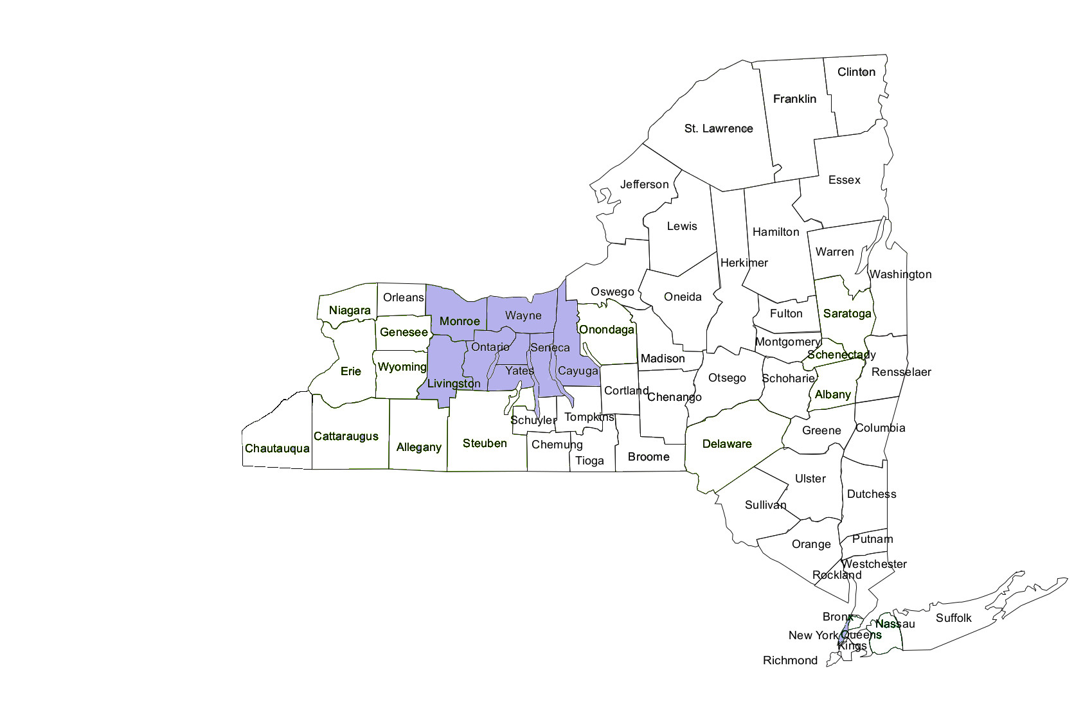
Original
Enhanced Multidisciplinary
Team Counties
Notes:
Risa

Slide 24
E-MDT Expansion Throughout NYS

Slide 25
Factors Influencing Expansion
Elder justice field determines MDT priority
  2010: NYS Summit recommendations
  2014: Elder Justice Roadmap
  2014: MDTs: Planning for Future symposium
  2016: Statewide report on elder abuse services
Govt Leaders Engaged
  2012: NYS Office for the Aging thru ACL-funded E-MDT initiative
  2014: Symposium
High Performing MDTs
  Upstate
  Downstate
Notes:
Paul

Slide 26
E-MDT Expansion – Phase 1
2016-17: State legislature allocates $500,000:
  Sustain E-MDTs
  Enhance NYCEAC’s Brooklyn team
  Expand E-MDTs to other localities
    Cases no longer need financial exploitation present
2017: New York City Department for the Aging contracts w/ Weill Cornell Medicine/NYCEAC to expand E-MDTs to all 5 boroughs
Notes:
Paul

Slide 27
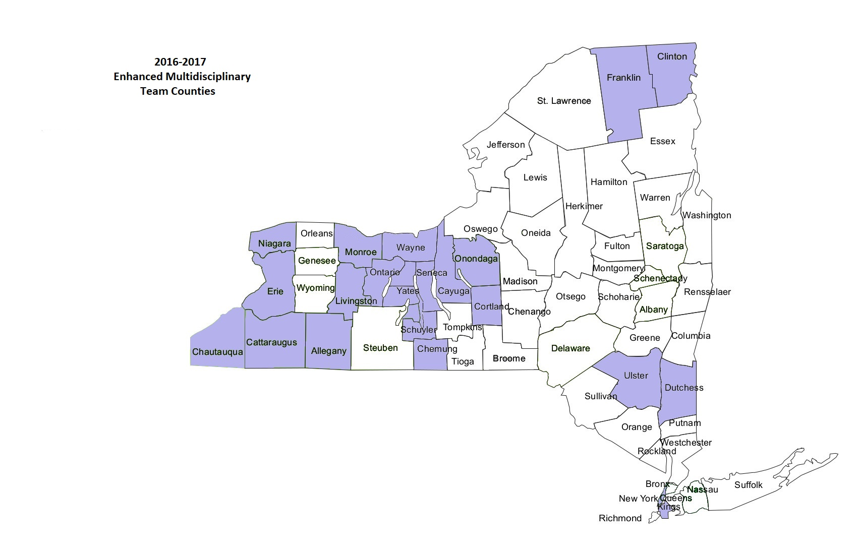
Current
Enhanced Multidisciplinary
Teams in NYS Counties
Notes:
Paul

Slide 28
E-MDT Expansion – Phase 2
2017-2018
NYSOFA partners w/ NYS Office of Victim Services (OVS)
  Leverage state funds to draw down federal VOCA (Victim of Crime Act) funds
  $2.5m from OVS with VOCA funds
  $500,000 state legislature 25% matching funds
AIM: EXPAND E-MDTs ACROSS ALL NYS COUNTIES
Notes:
Paul

Slide 29
NYS OVS:
Deepening Engagement with Elder Abuse
Explicitly stated interest in increased funding for elder abuse programs (and other underserved populations)
OVS MDT funding for 3 years
  Continuation of funds expected after 3 yrs.t
Crime victim compensation fund
  October 2017: “Vulnerable adult” expansion of definition and increase in crime victim compensation awards
Notes:
Paul

Slide 30

Contact Info
Paul Caccamise, LMSW, ACSW
  Vice President for Program
  pcaccamise@lifespan-roch.org
  www.lifespan-roch.org
  www.nyselderabuse.org
  585-244-8400 x115
Risa Breckman, LCSW
Director
New York City Elder Abuse Center
Weill Cornell Medicine
rbreckm@med.cornell.edu
www.nyceac.org
212-746-1674

Slide 31
Thank you!

Slide 32
Minnesota Elder Justice Center
Building an infrastructure for sustained effort in minnesota

Slide 33
Minnesota Elder Justice
Center
Roots
MISSION and PEOPLE
Milestones
Programs and Issues
Challenges

Slide 34

The story in a nutshell
The past was spontaneous combustion.
The present and future…
organizational development

Slide 35
Our Genealogy
Vulnerable Adult Justice Project (VAJP) – stakeholder group begun at a local law school
SAFE Elders Minnesota – public awareness project seeded by a County Attorney (District Attorney)
Short-term funding, volunteer efforts with limitless horizons and limited sustainability
VAJP and SAFE leaders work to establish the Center as a tax-exempt nonprofit, with Board and staff

Slide 36

Office opened October 1, 2014

Slide 37
Organization, Board and Staff Today
Mission – “mobilizing communities to prevent and alleviate abuse, neglect, and financial exploitation of elders and vulnerable adults”
Board (11) – most were active in the earlier projects
Staff (7) – some also active in the earlier projects
Major funders – MN Office of Justice Programs, Foundation grants, Corporate Contributions, MN Department of Human Services, AARP, Individual contributions

Slide 38
Our Milestones
Incorporation as tax-exempt non-profit
Anchor donors
Hiring Executive Director/ opening office at school
Opening independent office in St. Paul
Statewide outreach and training calendar
ED named to chair MN working group on security cameras in facilities
Launching Victim Services Program
Hiring Public Policy Director

Slide 39
Our Programs and Issues
Programs
  Professional Education
    Health care facilities
    Multidisciplinary teams
  Public Awareness – WEAAD Conference
  Victim Services and Guardianship complaint project
  State legislative advocacy

Slide 40
Our Programs and Issues
Minnesota Elder Justice Center Partner – stakeholders meet monthly
  Educational presentations
  Public Policy development (consensus-building)
Current Public Policy Issues
  Functional breakdown in state Office of Health Facility Complaints
  Assisted Living oversight
  Criminal penalties for abuse

Slide 41
Our Challenges
Programs
  Staffing to meet increasing calls for help
  Continuing commitment to evaluation
  Continuing gaps analysis and response
Board development
  Statewide representation
  Maintaining our differences and our functionality
  Encouraging new leaders
Public Policy
  Independent organization serving as backbone/facilitator to diverse stakeholder group

Slide 42
Minnesota Elder Justice Center
2610 University Avenue West, Suite 530
St. Paul, Minnesota 55114 www.elderjusticemn.org
Amanda Vickstrom, Executive Director
Amanda.Vickstrom@elderjusticemn.org
Iris C. Freeman iris.freeman@mitchellhamline.edu

Slide 43
Building an Elder Justice Movement State by State: Ohio
Georgia J. Anetzberger, PhD, ACSW

Slide 44
Ohio Coalition for Adult Protective Services (OCAPS)
Origins: 1984, started by three advocates (from Cleveland, Toledo, and Columbus) who believed that only a statewide effort could secure state funding for implementation of Ohio’s Adult Protective Services (APS) Law, enacted three years before
Mission: Statewide network that strives to enhance the provisions of services to adults at risk of abuse, neglect, and exploitation through education and advocacy
Auspice: Independent incorporated non-profit organization
Membership: Open to Ohio professionals and advocates interested in elder abuse issues; payment of annual dues required
Affiliations: Four regional groups of OCAPS members

Slide 45
Ohio Coalition for Adult Protective Services (OCAPS) (continued)
Committees: Executive, Steering, Public Policy, Education and Resource, Membership, and Development
Programs: Ohio HOPES (provides resources, a monitored helpline, and support in reporting crimes), annual conference, and listserv
Staff: Part-time, grant funded
Fiscal Management: Ohio Association of Area Agencies on Aging

Slide 46
OCAPS Public Policy Committee
Description: (1) Advocates for increased funding/resources to implement fully APS and elder abuse laws, (2) studies and identifies gaps in existing state and federal elder abuse legislation, (3) identifies and networks statewide with other advocacy organizations on policy issues, and (4) maintains and disseminates updated information on pending and current legislative and public policy issues relevant to APS
Meetings: Bimonthly

Slide 47
Ohio Elder Abuse Commission (EAC)
Origins: 2003, formed in the aftermath of the National Public Policy Summit on Elder Abuse (2002) and subsequent Ohio Post-National Summit (recommended the establishment of a statewide effort directed at problem awareness, education, and response coordination, policy, and funding)
Purpose: Promotion of state agency collaboration in addressing the mistreatment of older Ohioans
Auspice: Attorney General’s Office
Membership: State government agency or statewide association representatives; appointment required

Slide 48
Ohio Elder Abuse Commission (EAC) (continued)
Committees: Policy, Direct Services, Research, and Education
Programs: Elder Justice Initiative (aims to increase the investigation and prosecution of elder abuse cases and improve victims’ access to service)
Staff: Full-time equivalent

Slide 49
EAC Policy Committee
Status: Recently appointed chair just beginning to convene meetings
Possible Actions: EAC Ad Hoc Group in the process of identifying possible strategic directions for consideration by Commission members, including some relevant to policy, such as:
(1) amendment of the APS Law to include vulnerable adults age 18-59,
(2) expansion of APS jurisdiction in licensed care facilities, and
(3) specific definition in APS Law regarding capacity to consent/lacks capacity to consent

Slide 50
OCAPS/EAC Policy Connections: Staff/Member Crossovers
Note: Other networks include: Ohio Association of Area Agencies on Aging, Policy Matters Ohio, Advocates for Ohio’s Future, Action Ohio, Ohio Domestic Violence Network, Ohio Job and Family Services Directors Association, and Ohio Association of Probate Court Judges
OCAPS
EAC
Other Networks

Slide 51
2017 Key Collaborative Policy
Successes in Improving Ohio’s Response to Elder Abuse
Funding: Added $100,000 annually to state funding for APS (goal: sufficient to fund one full-time APS worker in each of Ohio’s 88 counties)
Law Enactment: Passage of HB 49 which, effective September 29, 2018:
(1) significantly expands and strengthens APS Law (e.g., adds many new mandatory reporters, particularly first-responders and those in finance; establishes a uniform statewide automated APS information system; adds “abandonment” as a form of neglect; expands perpetrators under exploitation from just “caretakers” to any “person”), and
(2) creates in the Ohio Revised Code (ORC) the Elder Abuse Commission (specifying its composition, functions, and reporting responsibilities)

Slide 52
ORC 5101.74-741 Elder Abuse Commission
There is hereby created the elder abuse commission. The commission shall consist of the following members…approved by the attorney general
-18 appointments, usually representing specific professional associations
-13 ex-officio members, usually representing specific state agencies or legislative bodies
(2) The EAC shall formulate and recommend strategies on all of the following:
- increasing awareness of and improving education on elder abuse
- increasing research on elder abuse
- improving policy, funding, and programming related to elder abuse
- improving the judicial response to elder abuse victims
- identifying ways to coordinate statewide efforts to address elder abuse

Slide 53
California Elder Justice Coalition (CEJC)

Slide 54
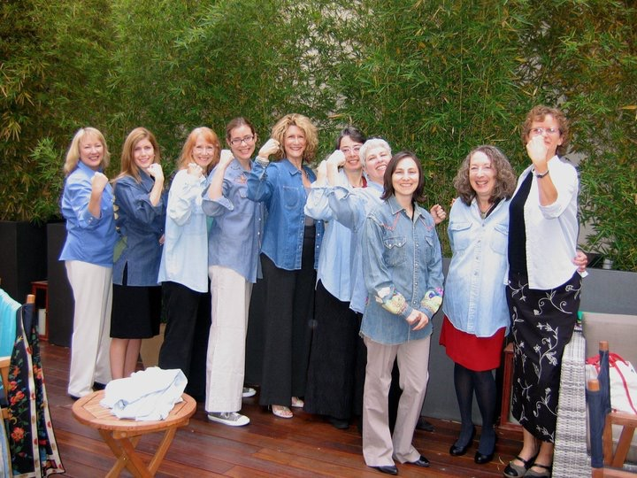
Our Humble Origins
2008: Workgroup started by participants in Archstone Foundation’s Elder Abuse/Neglect Initiative to:
  Explore systems problems and promising solutions
  Provide opportunities to share information and build consensus
  Provide voice from the field in policy
  Provide policy makers with streamlined, nonpartisan, interdisciplinary information

Slide 55

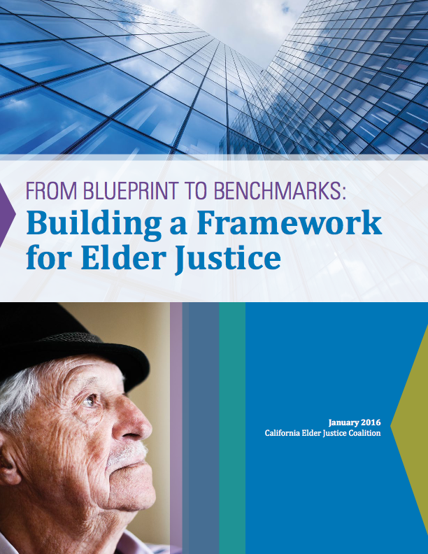
The Plans

Slide 56
Topics
      Modernizing Adult Protective Services (APS)
      Elder Abuse in Institutional Settings
      Preventing Caregiver Abuse
      The Legal System’s Role
      Fair Access to Services and Resources
      Long-Term Services and Supports (LTSS)
      Financial Abuse and Exploitation
      Victims Rights and Service Needs
      The Federal Role

Slide 57
Principles of Elder Justice
  Right to live free from abuse, neglect, and exploitation
  Access to services that promote independence and autonomy
  Access to justice system; includes victims rights and services
  Parity with other populations for services and benefits
  Parity within elderly population
  Consumer rights and protections, including LTSS consumers LTC facility residents
  Protecting the rights and autonomy of people with cognitive impairments

Slide 58
Accomplishments
Strengthened California's adult protective services program
• Spearheaded successful effort to create a state APS leadership position
• Successfully advocated for new training dollars for APS
Developed comprehensive strategic plans
• Hosted 2 state summits
• Produced comprehensive blueprints
Helped develop services for victims under VOCA
• Alerted VOCA administrators to unmet needs resulting in 13 MDTs and more
• Provide training and technical assistance to VOCA

Slide 59
Accomplishments (cont)
Raised awareness about elder justice among policy makers
• Brown bag sessions and policy workshops with policy makers
• Technical assistance to lawmakers and administrators in drafting laws/regulations
• Testimony, policy briefs, & fact sheets
Mobilized network
• Launched CEJC as member organization
• Partnerships with state/federal advocacy groups
• Represent CA's elder justice network at state/national forums
Explored emerging issues and challenges
• Preventing Abuse by Caregivers
• Elder justice in the age of managed care
• Homeless, incarcerated, reentering older people

Slide 60
Advocates Academy
Create a corp of advocates with skills/expertise in policy
introduce EJ advocates and policy makers
Provide mentoring opportunities
Build skills in identifying and demonstrating needs
Work collectively to improve service delivery

Slide 61
Unfinished Business
Extend Victim Compensation to financial crime victims
Launch A*TEAM to address systemic issues
Blue Ribbon Panel
Help mobilize national elder justice movement

Slide 62
Discussion
Lisa Nerenberg,
Moderator

Slide 63

What are….
Significant commonalities and differences?

Slide 64

What are…
Some unexpected outcomes?

Slide 65
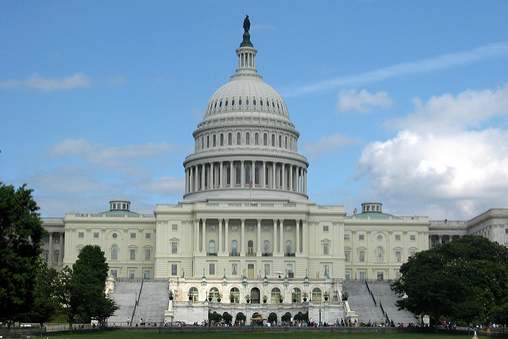
How about….
Work on federal policy?

Slide 66
Need for a National Movement?

Slide 67
Thank you

